Slide 1

University of California San Diego: School of Global Policy and Strategy
Date
Class
Title Page
Written and presented by: Edgar Agunias

Slide 2
University of California San Diego: School of Global Policy and Strategy
Date
Title
Transition Page/Color
Red Yellow
Blue
Green

Slide 3
Title
Quote Page
"amount of effort required by police to compel compliance by an unwilling subject"
National Institute of Justice

Slide 4
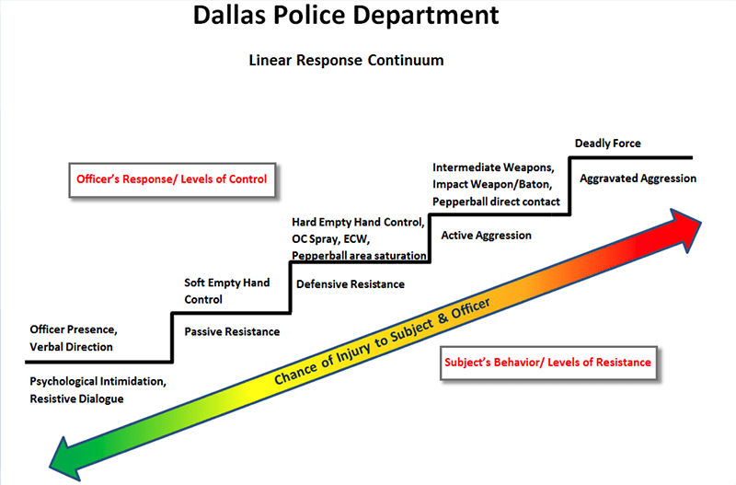
Graph/Image Page

Slide 5
The Cost of Corruption: An Economic Analysis
Research Question?
How do the real life events affect the level of force used in Law and Order?
Sub Questions:
Specifically, how does Rodney Kings 1992 beating change or not change narratives?
Moreover how do factors such as SES, Age, and Sex change depictions on screen?

Slide 6
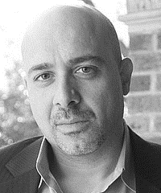
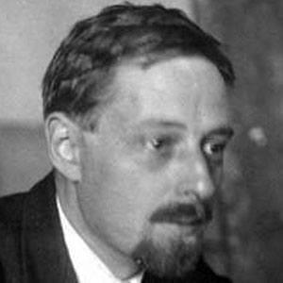


Scripted Justice
Theoretical Framework
Frameworks:
A Theory of Scandal: Victorians, Homosexuality, and the Fall of Oscar Wilde (Ari Adut, 2005)
Morphology of the Folktale (Vladimir Propp 1928)
"All Hits Are Flukes": Institutionalized Decision Making and the Rhetoric of Network Prime-Time Program Development (Bielby & Bielby 1994)
Notes:
Corruption is a human interaction, it is not purely a economic/market failure.

Slide 7
Scripted Justice
Sample Set
60 Episodes analyzed (14% of 456 Episodes from 1991-2010)
65 Instances of Force Recorded
Notes:
Human capital and corruption relationship shows why some countries continue to remain poor and have high levels of corruption, explaining the earlier general effects through brain drain and compounding impact of corruption.

Slide 8
University of Amsterdam
Faculty of Social Sciences
Sociology
June
2024
Scripted Justice
Conclusions

Slide 9
Scripted Justice
Conclusion
Use of force did not change statistically
Notes:
It is a network under which the adaptability and extensiveness of the network causes a multi equilibrium point.

Slide 10
Scripted Justice
Conclusion
SES was the greatest determining factor besides sex

Slide 11
Scripted Justice
Conclusion
Race was not found to be statistically significant, differing greatly from real world data

Slide 12
University of California San Diego: School of Global Policy and Strategy
Date
Title
Any Questions?

